Slide 1
Module 15

Slide 2
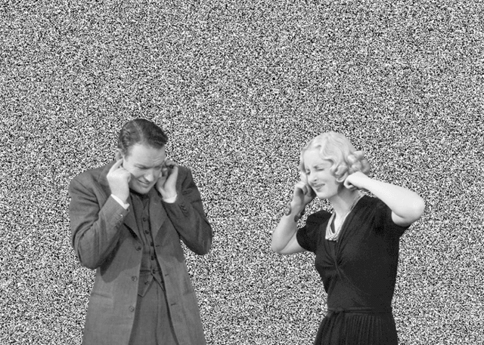
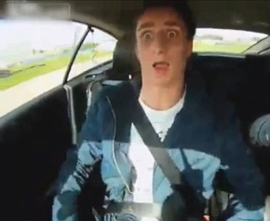
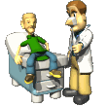
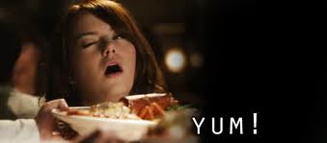

What would you do when ?
When you see a motor car coming towards you
or when you see something delicious
or suddenly you hear a loud noise
or if a doctor gives a jerk on the knee.
Can we control our reactions during these situations.
NO !
How can we react in such situations without thinking ?

Slide 3
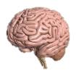
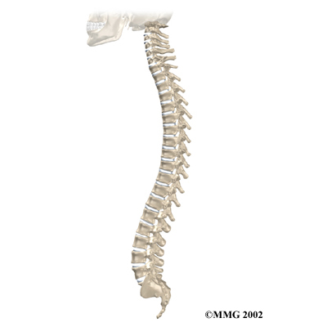

Suppose a boy touches a flame
If he thinks consciously about the flame then
Impulses will generate and travel through sensory neuron to spinal cord and brain and comes back through motor neuron to the effector muscle.
It will take time and he will get wounded.

Slide 4
The other possible way can be

Slide 5
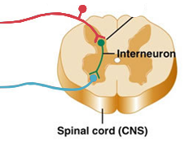
If he doesn’t think about the pain then
In the spinal cord impulses will move from sensory neurons to motor neuron through inter neuron
Nerves from all over the body meeting in a bundle such a connection is called as spinal cord where reflex arcs are formed.
Hence the action will be completed quickly.
Impulses will generate and travels through sensory neuron to spinal cord.
So the nerves that detect pain are connected to the nerves that bring about movement of the muscles.

Slide 6
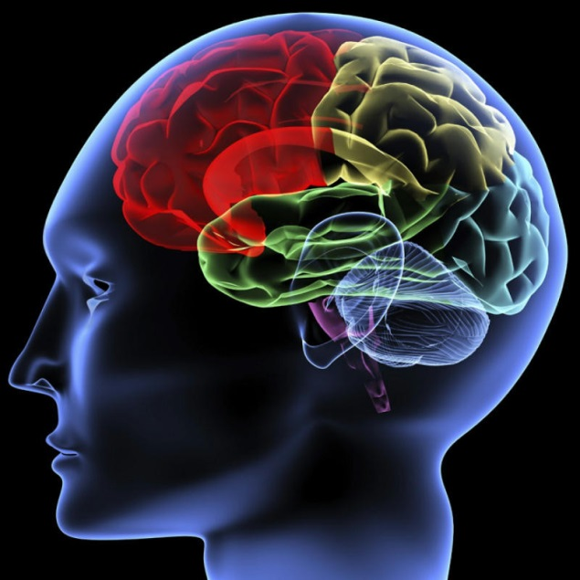

Reflex Action
Reflex arcs are perhaps evolved in animals because the thinking process of the brain is a bit slow.

Slide 7
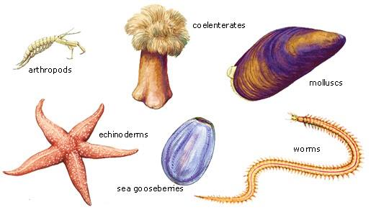
Reflex Action
In many animals, especially lower animals the complex neuron network needed for thinking is not there or is not well developed.

Slide 8
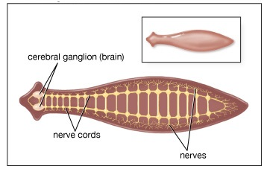
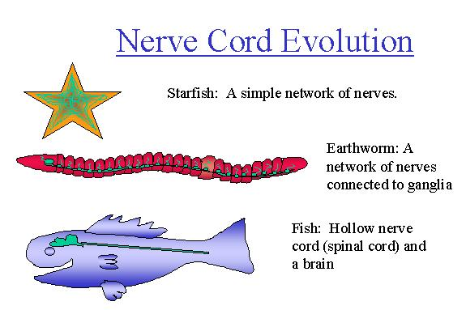
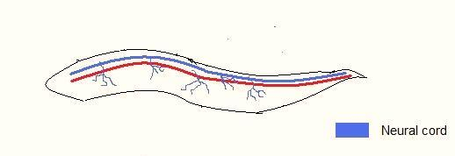
Reflex Action
Hence the reflex arcs have been evolved as efficient ways of functioning in the absence of the true thought processes.

Slide 9

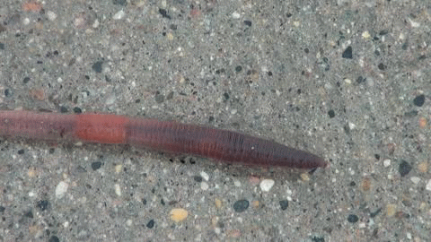
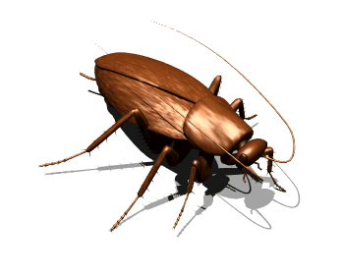
Reflex Action
However, in spite of the presence of complex neuron networks, reflex arcs continue to be more efficient for quick responses.

Slide 10
Thank You

